Slide 1
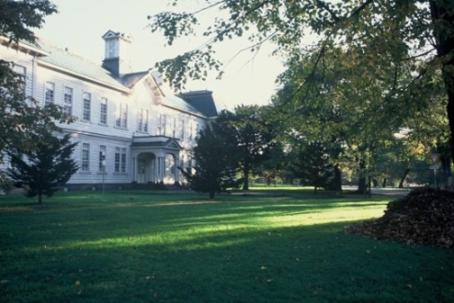
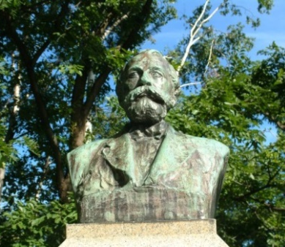
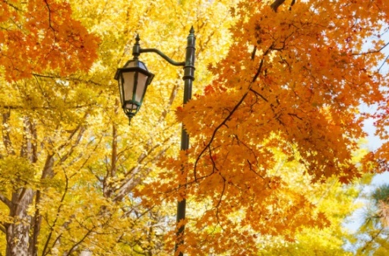
Introduction to Hokkaido University
Toyoharu NAWA, Ph.D.
President, Hokkaido University
September 28th, 2017

Slide 2

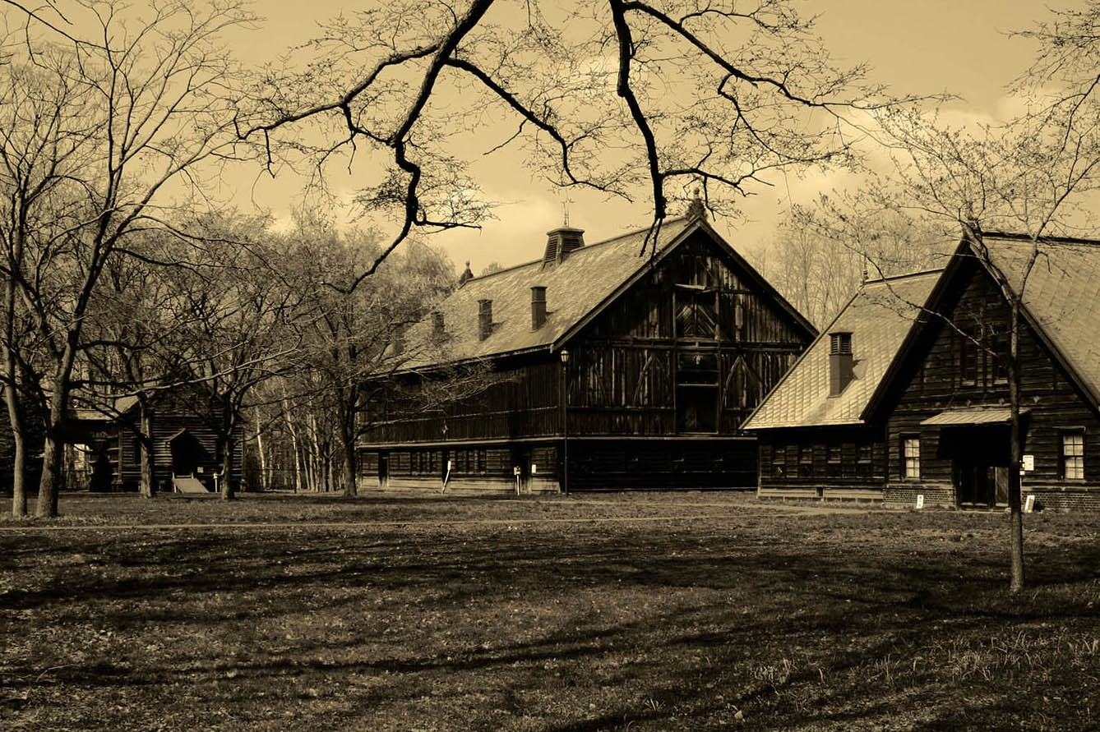
Contents
Hokkaido University
Education and Research
Internationalization
Rankings
Cost of Living

Slide 3
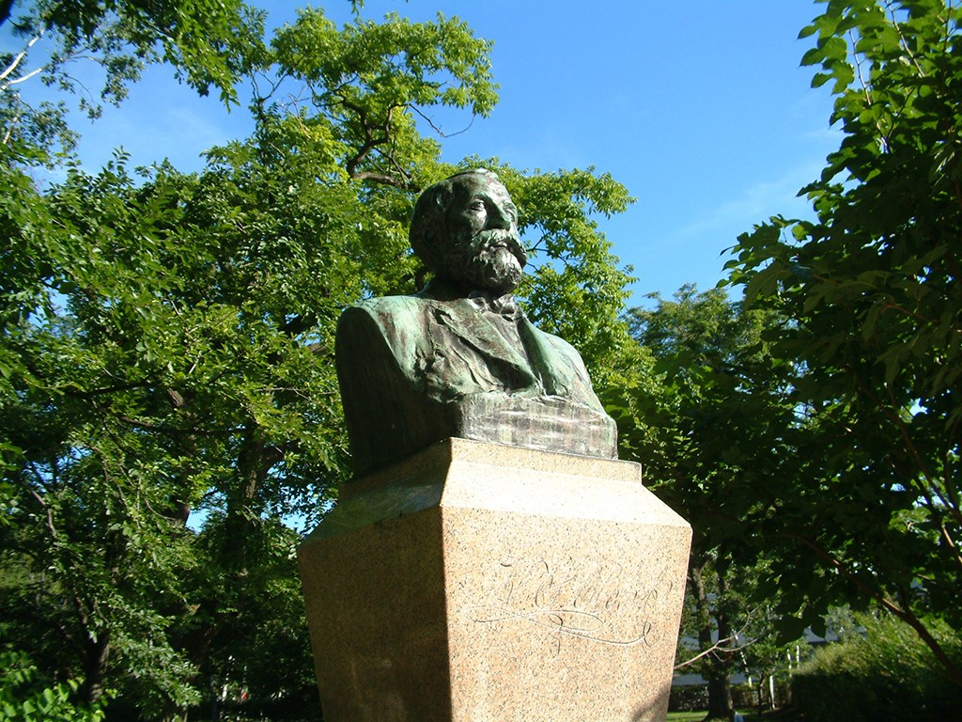
1. Hokkaido University
Dr. William S. Clark

Slide 4
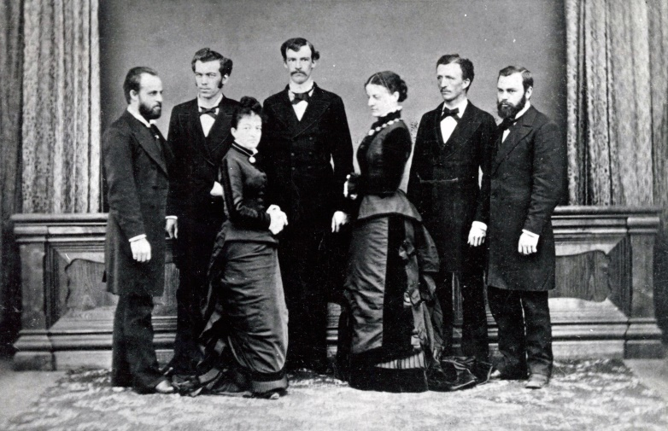
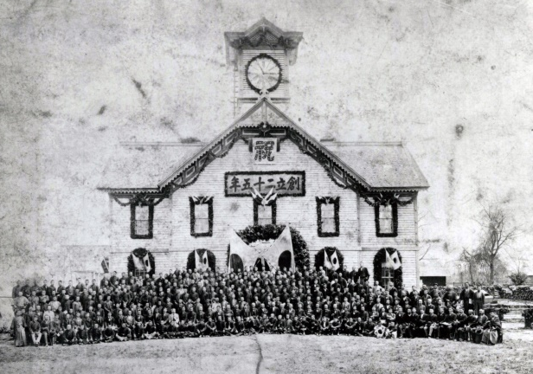
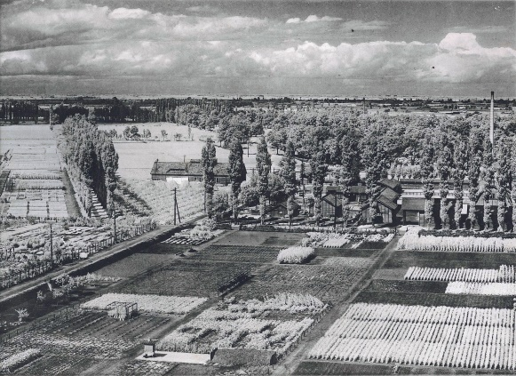
History and tradition
Edo Period
1868
1876
Established as Sapporo Agricultural College
1907
Becomes Tohoku Imperial University
1918
Becomes Hokkaido Imperial University
1947
Renamed to Hokkaido University
2017
History of over 140 years !
Notes:
(From the top)
American professors of Sapporo Agricultural College and two wives (1879)
25th Anniversary of the Military Drill Hall for Sapporo Agricultural College (currently Sapporo Clock Tower) (1901) *
* The Clock Tower was designated as a National Important Cultural Property in 1970 and is now a museum that is also used for various cultural activities.
See detail: http://sapporoshi-tokeidai.jp/english/
University farm (1937)
Photographs provided by the Hokkaido University Archives
September 25th, 2017
写真上から
1.札幌農学校アメリカ人教師とその夫人たち（1879年）
2.創基25周年記念 旧札幌農学校演武場（1901年）
※国指定重要文化財 旧札幌農学校演武場 札幌市時計台
3.大学附属農場（1937年）
以上，北海道大学文書館所蔵による資料提供
http://www.hokudai.ac.jp/bunsyo/

Slide 5
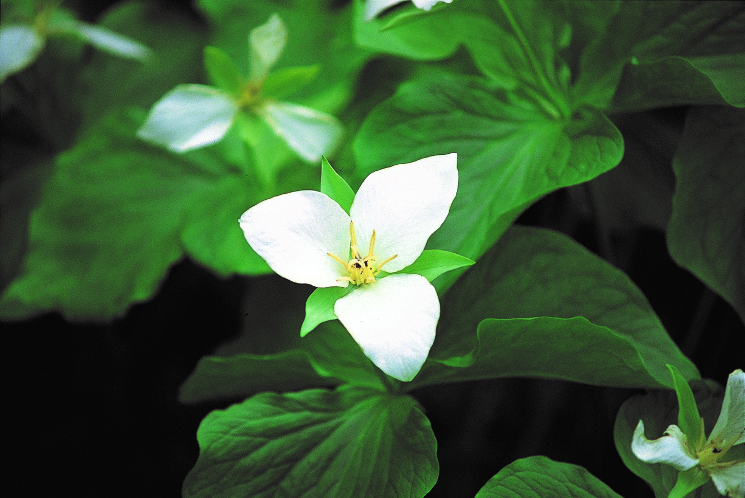
Basic Philosophies of Hokkaido University (HU)
Frontier
Spirit
Practical Learning
Global Perspectives
All-round Education

Slide 6
Location
5th : Sapporo
2.0 million
The population of Japan
127 million
4th : Nagoya
2.3 million
1st : Tokyo Metropolitan Districts
9.4 million
2nd : Yokohama
3rd : Osaka
3.7 million
2.7 million
Data as of Oct 2016

Slide 7
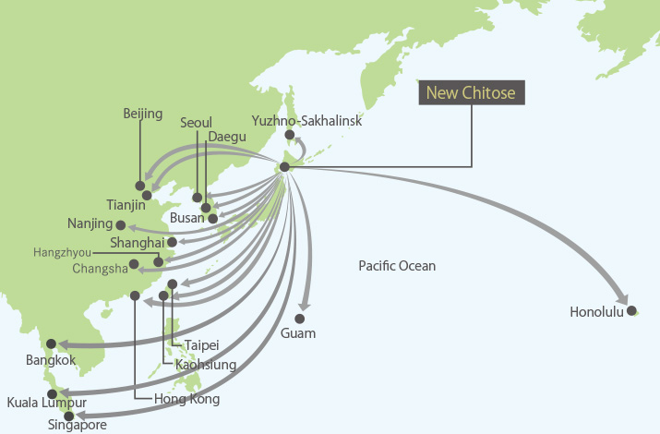

Location/Hokkaido
Sapporo City Location
Latitude and Longitude
North - 43°11‘N.lat.---
South - 42°46‘N.lat.---
East - 141°30‘E.long.---
West - 140°59‘E.long.---
Sapporo Campus
Hokkaido Pref.
New Chitose Airport
* Sapporo City Population (2016) : 2.0 million
Sapporo City Climate (2016)
Average Temperature : 9.3 ℃ ( 48.7 ℉ )
Highest Temperature : 31.9 ℃ ( 89.4 ℉ )
Lowest Temperature : -10.9 ℃ ( 12.4 ℉ )
Cumulative Precipitation : 1,360mm
Cumulative Snowfall : 428cm
Hakodate Campus Fisheries Sciences
* Hakodate City Population (2016) : 0.27 million

Slide 8
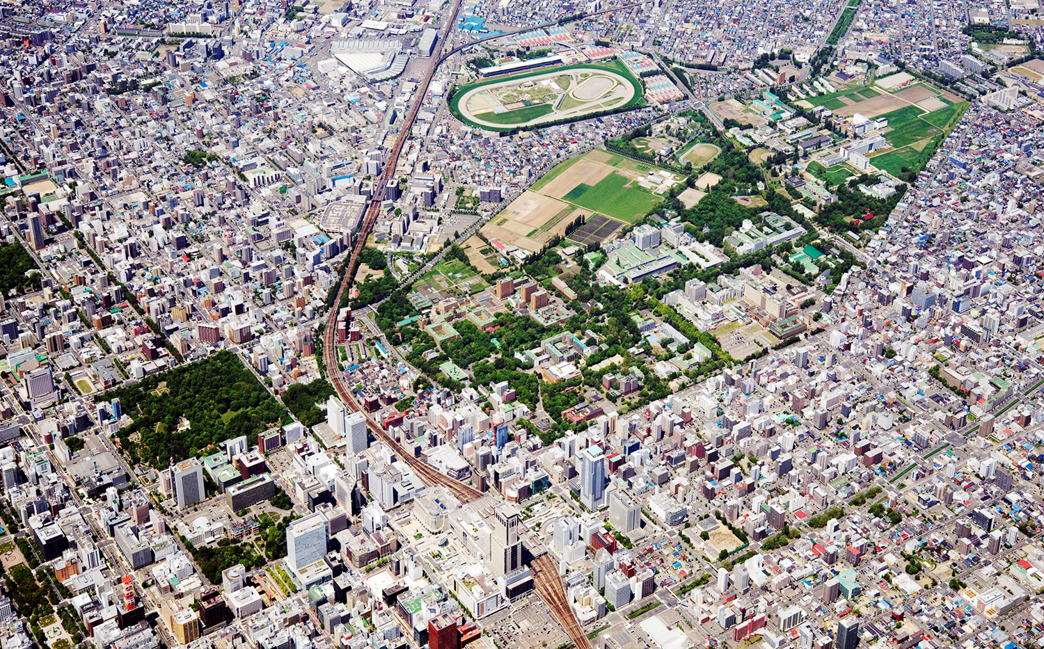


Beautiful campus in the heart of Sapporo
Dormitory
Dormitory
2.4km
1km
Botanic Garden
Sapporo Sta.
Dormitory

Slide 9
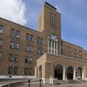
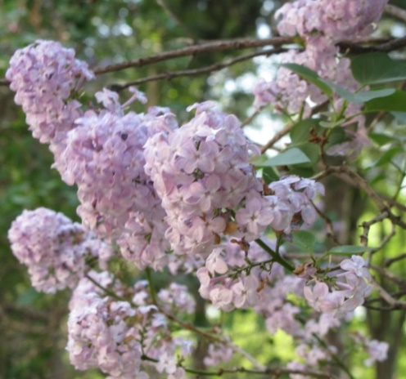
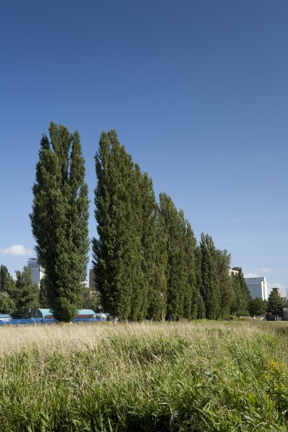
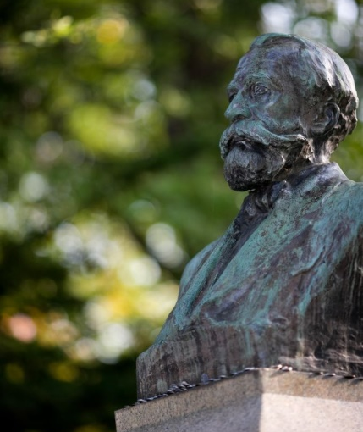
Basic Data
Data as of May 2017
* June 2017
Undergraduate Schools |  | 12
Graduate Schools |  | 21
Research Institutes / Centers |  | 22
Staff | Total | 4,004
 | Executives and Vice Presidents | 8
 | Academic | 2,070
 | Admin./Technical | 1,926
Students | Total | 18,273
 | Undergraduate | 11,935
 | Graduate | 6,338
Acreage | Total | ca. 660km² (66,000 ha)
 | Sapporo Campus | ca. 2.9km² (290 ha)
 | Hakodate Campus | ca. 0.11km² (11 ha)
 | Research Forests | ca. 657km² (65,700 ha)
Budget | Total | ca. 96.4 billion JPY (ca. 862 million USD)
Including 127 *
International Staff Members
Including 1,891
International Students
Notes:
See slide 10’s notes

Slide 10
Number of Staff and Students
Data as of May 2017
* June 2017
Staff
Total: 4,004
Including 127 *
International Staff Members
Executives and Vice Presidents 8 / Academic Staff 2,070 / URA Staff 14 / Administrative Staff 901 / Technical Staff 983 / Specialist, etc. 28
Student
Total: 18,273
Including 1,891
International Students
Undergraduate Courses: 11,935
Regular Students 11,436 / Research Students 69 / Auditors 430
Graduate Courses: 6,338
Master’s Course 3,598 / Professional Course 209 /
Doctoral Course 2,279 / Research Students 207 / Auditors 45

Slide 11
Structure of Education and Research
Hokkaido University
Undergraduate Schools
12
- Institute of Low Temperature Science
- Institute for Genetic Medicine
- Research Institute for Electronic Science
- Institute for Catalysis
Graduate Schools
21
Research Institutes
4
- Slavic-Eurasian Research Center
- Research Center for Zoonosis Control
- Information Initiative Center
Library
- Center for Ainu and Indigenous Studies
- Central Institute of Isotope Science
- Center for Language Learning
- Center for Environmental and Health Science
- etc.
Research Centers
3
Joint-usage Facilities
15
Notes:
Research Institutes(4)
- Institute of Low Temperature Science
-- Pan-Okhotsk Research Center
- Institute for Genetic Medicine
-- Institute for Animal Experimentation
-- Center for Infection-Associated Center
- Research Institute for Electronic Science
-- Green Nanotechnology Research Center
-- Research Center of Mathematics for Social Creativity
- Institute for Catalysis
-- Catalysis Collaborative Research Center
Research Centers(3)
- Slavic-Eurasian Research Center
- Research Center for Zoonosis Control
- Information Initiative Center
Joint-usage Facilities(15)
- Research Centers(8)
-- Central Institute of Isotope Science
-- Research Center for Integrated Quantum Electronics
-- Field Science Center for Northern Biosphere
-- Center for Advanced Tourism Studies
-- Center for Ainu and Indigenous Studies
-- Center for Experimental Research in Social Sciences
-- Center for Environmental Health Sciences
-- Arctic Research Center
- Educational Centers(3)
-- Research and Education Center for Brain Science
-- Center for Language Learning
-- Education and Research Center for Mathematical and Data Science
- Specific Operations(4)
-- Hokkaido University Museum
-- Hokkaido University Archives
-- Health Care Center
-- Archaeological Research Center

Slide 12
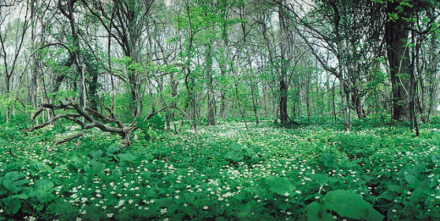
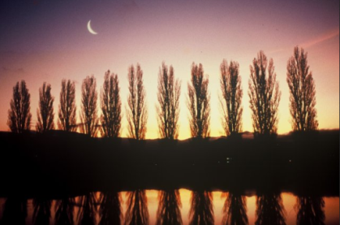
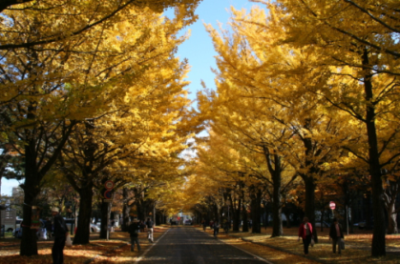
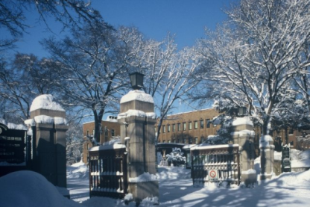
Undergraduate and Graduate Schools
Undergraduate Schools: 12
Letters, Education, Law, Economics and Business, Science, Medicine, Dental Medicine, Pharmaceutical Science and Pharmacy, Engineering, Agriculture, Veterinary Medicine, Fisheries Sciences
Graduate Schools: 21
Letters, Law, Information Science and Technology, Fisheries Sciences, Environmental Science, Science, Agriculture, Life Science, Education, International Media, communication and Tourism Studies, Health Sciences, Engineering, Chemical Sciences and Engineering, Economics and Business, Medicine, Dental Medicine, Veterinary Medicine, Biomedical Science and Engineering, Infectious Diseases, Global Food Resources, Public Policy

Slide 13
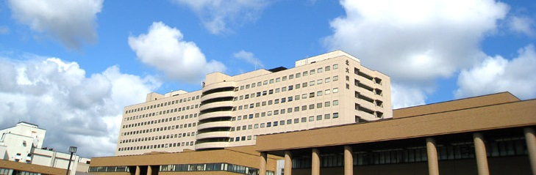
Hokkaido University Hospital
Our Mission
The mission of Hokkaido University Hospital is to improve the health of our community and the world through excellent patient-centered medical care services. Specifically, we strive:
To provide the highest quality medical care and patient-centered services
To produce health professionals with the highest character and greatest skills
To develop and provide advanced medical and healthcare solutions
To contribute to the healthcare needs of the local and global community
Number of beds and patients
Figures from April 2016 - March 2017
Clinical departments: 41
Number of beds: 939
Outpatients
Total number: 738,499
Average/day: 3,039.1
Inpatients
Total number: 292,829
Average/day: 802.3

Slide 14
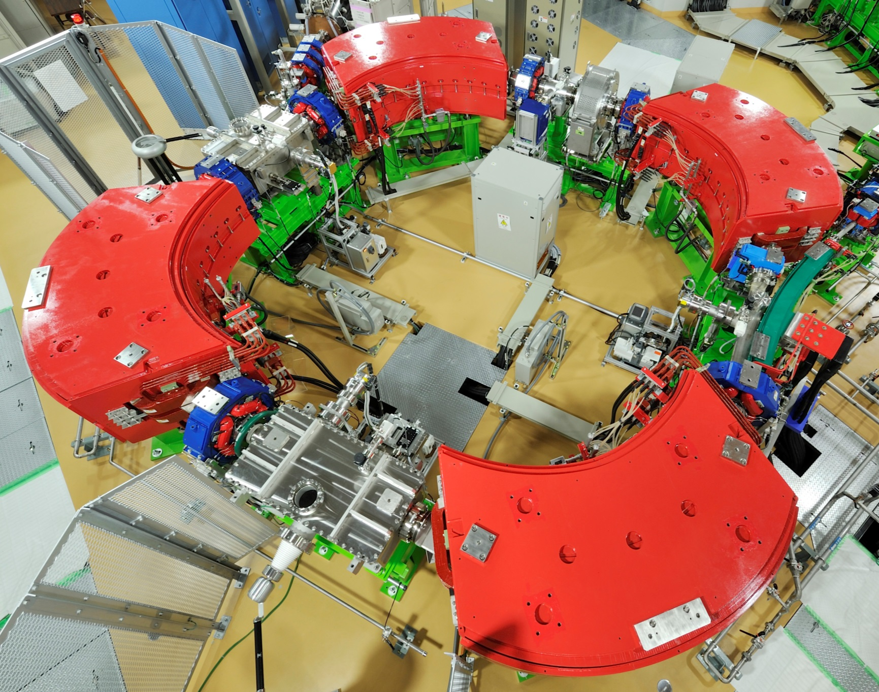
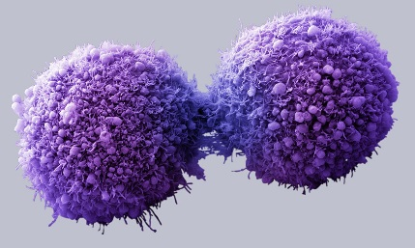
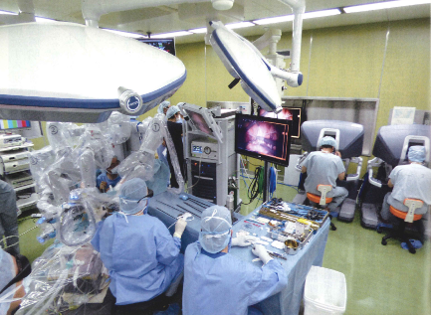
Hokkaido University Hospital Globalization Initiatives
1) Medical Care for Inbound Foreign Patients
・Advanced Medicine
Proton Beam Therapy
Cell Therapy
Robotic Surgery
・Patient Services
Medical Interpreters
Multi-cultural Hospital Environment
- 3 minutes walk to Sapporo Masjid
- Personalized foodservice
Medical Visa, Travel Assistance, Family Residence
- Services provided through Emergency Assistance Japan

Slide 15
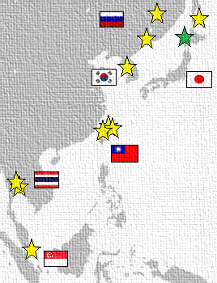


Hokkaido University Hospital Globalization Initiatives
2) Education
Continuing Medical Education (CME) Courses for Foreign Physicians
Clinical Clerkships for Overseas Residents and Fellows
Global Education Course for Japanese Trainees
3) Exchange Agreements with Hospitals Abroad
USA: 2
Spain: 1
Russia: 3
Singapore: 1
Thailand: 2
India: 1
Taiwan: 3
Korea: 1
4) Outbound Advanced Medicine
Proton
Beam
Therapy
USA
Singapore

Slide 16
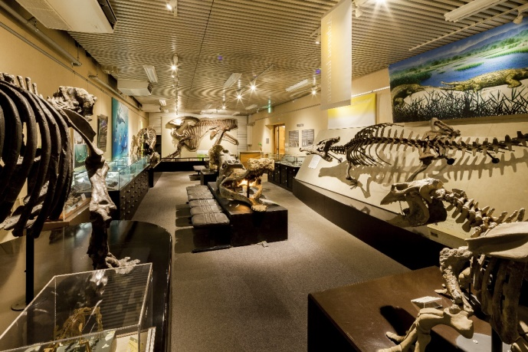
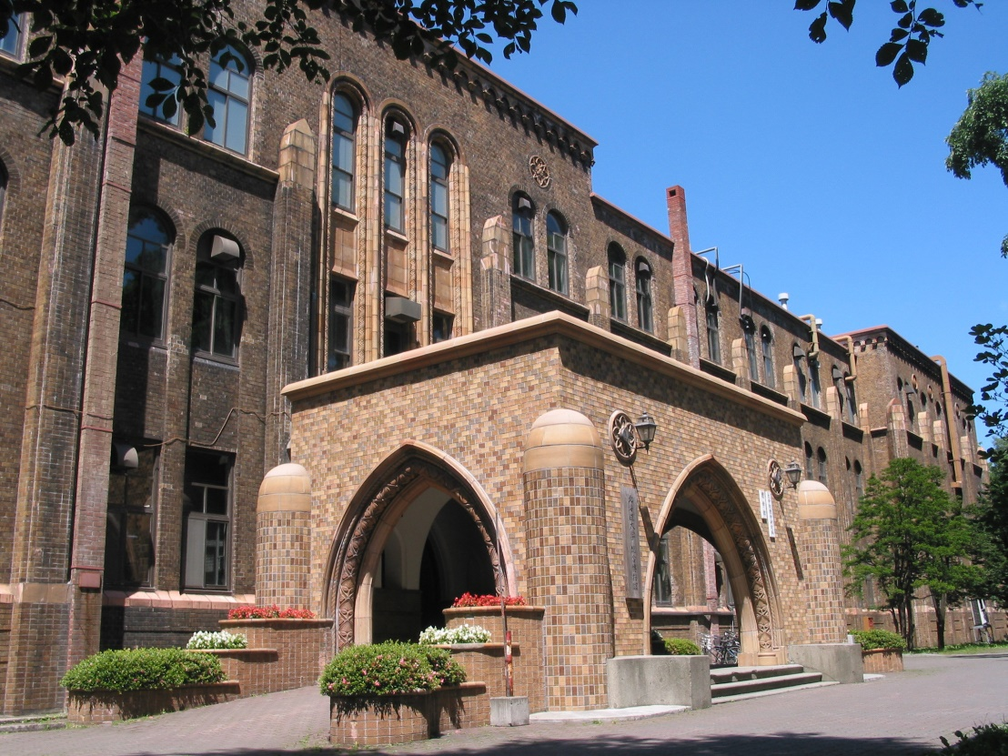
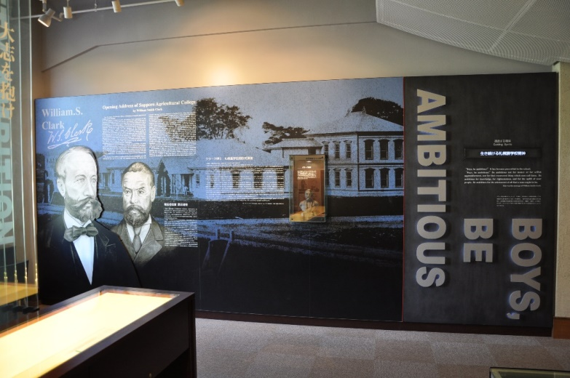
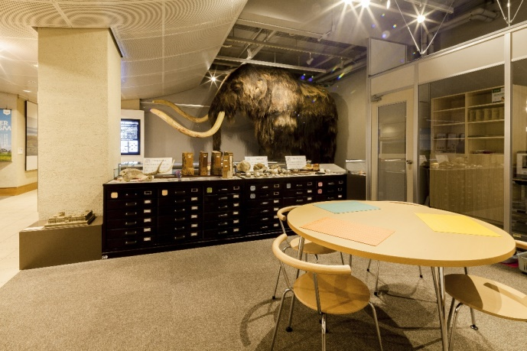
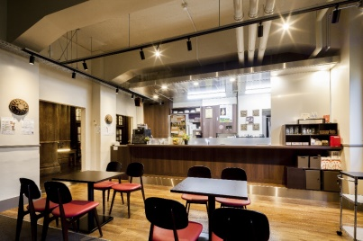

Hokkaido University Museum

Slide 17
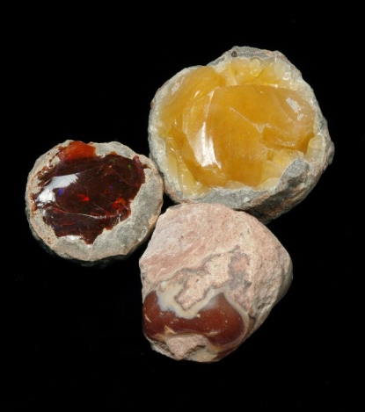
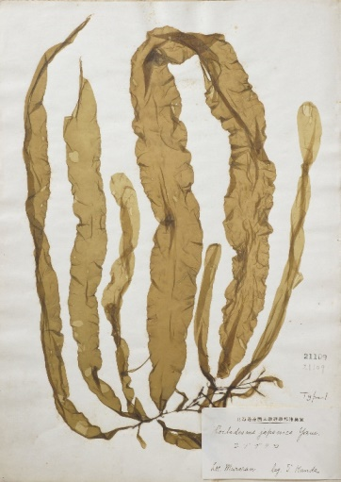
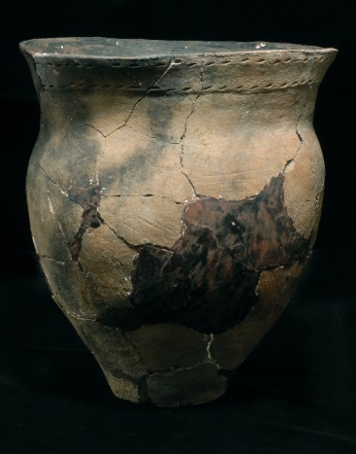
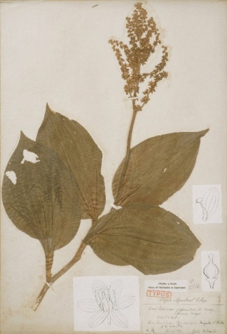
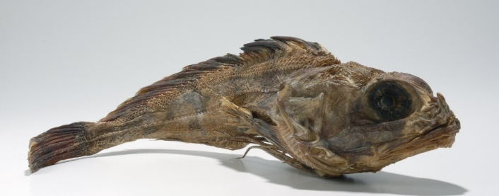
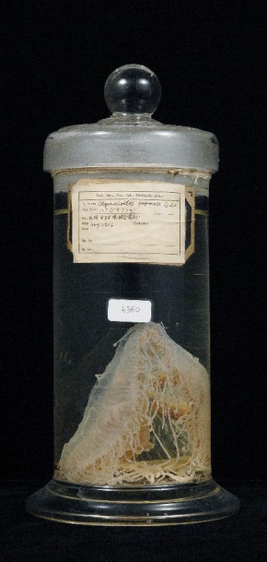
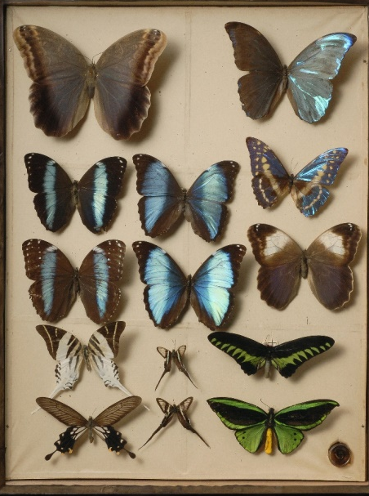
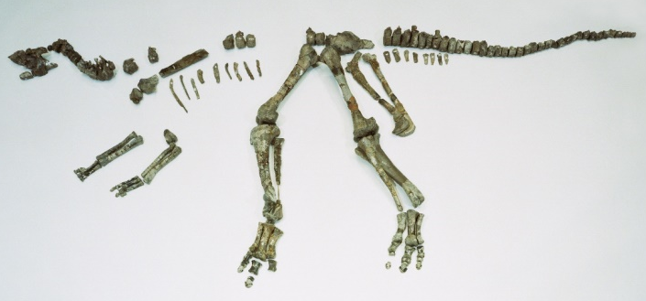
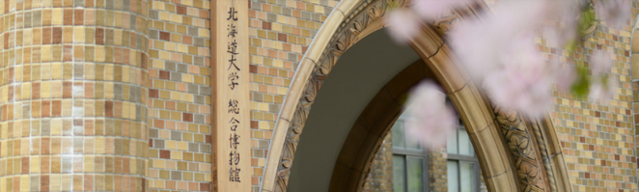
Hokkaido University Museum
Main academic specimens collected
Museum Timeline
April 1999
Museum opens to the public
November 2014
Number of visitors
surpasses one million
From April 2015
Earthquake strengthening
construction works
July 2016
Renewed museum reopens
Rocks & Minerals:
71,350
Plants: 400,000
Fungi: 170,000
Seaweed: 140,000
Artifacts: 30,000
Fishes: 210,000
Invertebrates:
2,425
Extinct animals: 20,000
Insects: 2,500,000

Slide 18
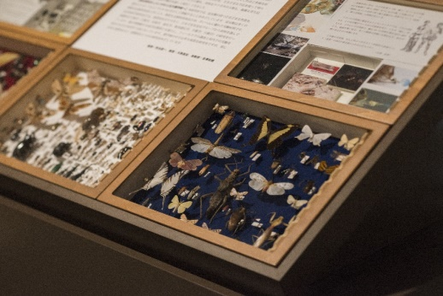
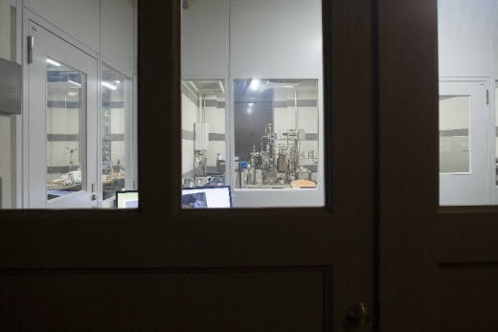

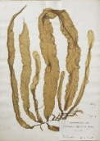
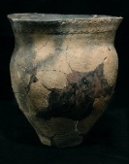

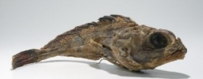
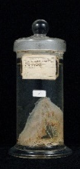

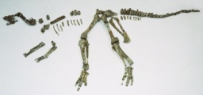
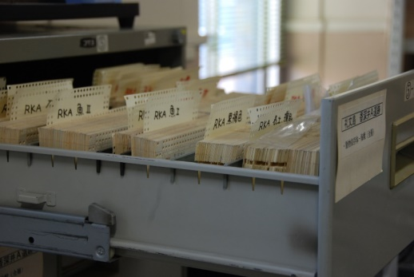
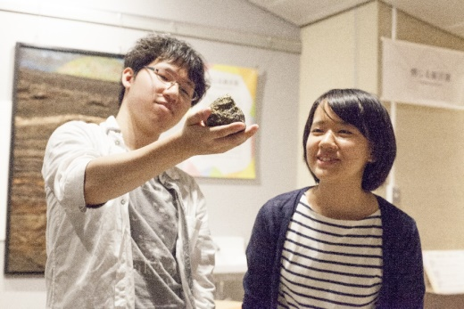
Hokkaido University Museum
Role of the Museum
Boosts the university’s charm！
Disseminates the university’s specialties
・Showcases advanced research achievements
・Appeals to prospective & international students
Gives back to society
・Research achievements which benefit the
community
・Lifelong learning
Exhibition
Research
A museum society loves！
A museum open to everyone
・Free admission
・Accessible to individuals with disabilities
Towards the exchange of knowledge
・Place for locals and researchers to meet
・Science Cafe
Academic Specimens
Undergraduate and Graduate Education
・Lectures
・Thesis & dissertation guidance
・Museum Meister Course
Education
Reuse
Lifelong Learning （services aimed at the general public）
・Volunteer activities： 191 people in 16 different fields as of April 1st, 2017
・Local citizens seminars： 41 seminars in the 2016 fiscal year
・Para taxonomist Training Course: 3 courses in the 2016 fiscal year

Slide 19
Budget
Revenue Budget for Fiscal Year 2017
Total: 96,379 Million Yen
Operational Grants
Tuition and Fees 9,389 (9.7%)
Hospital Earnings
Facility Maintenance Grants
1,402 (1.5%)
Research Grants etc.
35,458
(36.8%)
28,466
(29.5%)
20,230
(21.0%)
Miscellaneous 1,435 (1.5%)
Expenditure Budget for Fiscal Year 2017
Total: 96,379 Million Yen
Personal Costs
Long-term Loan Redemption 1,514 (1.6%)
Operational Costs
Facility Maintenance Costs
1,402 (1.5%)
Research Grants etc.
44,843
(46.5%)
28,191
(28.3%)
20,230
(21.0%)
Adjustment Costs
200 (0.2%)

Slide 20
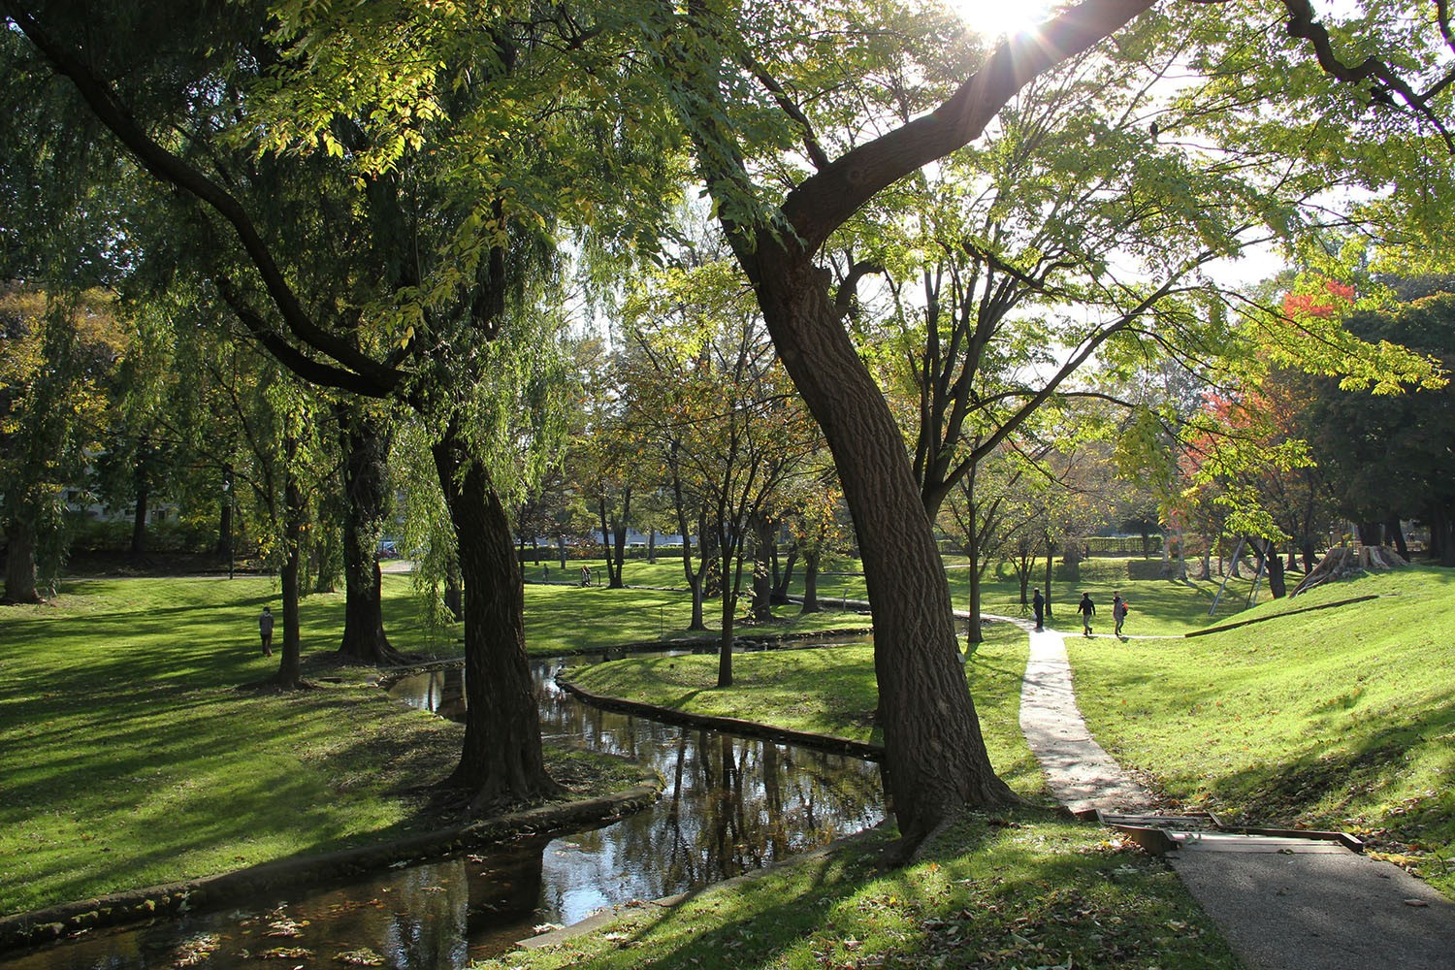
2. Education and Research

Slide 21

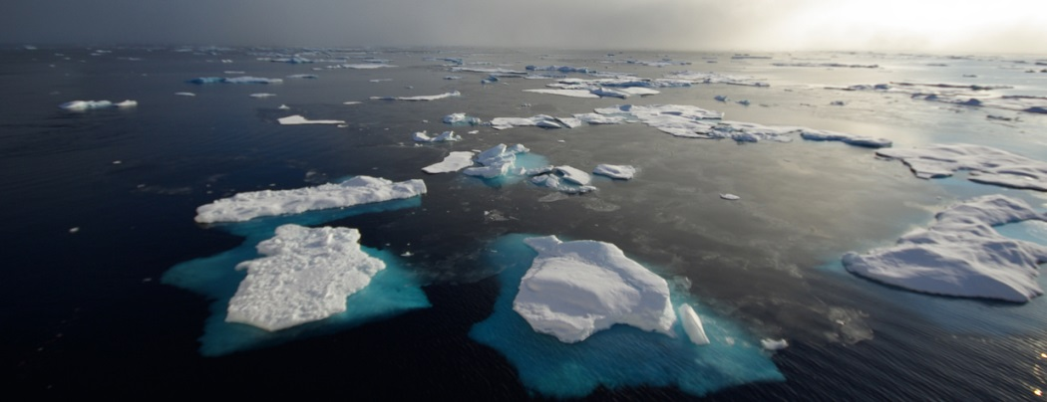
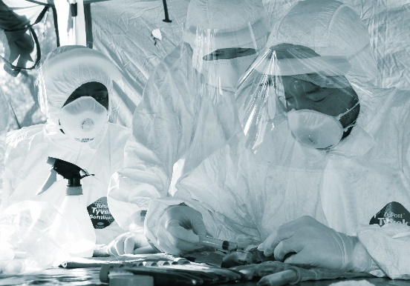


Future Strategy Contributing towards the resolution of global issues
Hokkaido University fosters leaders contributing to the resolution of global issues through transforming the university into a world initiator in collaborations with overseas universities and institutions.
Arctic Research Center
Zoonosis Control
Arctic Research Center aims to work out solutions to global problems through comprehensive and integrated research on the Arctic.
It contributes to policy making as a national research center.
The Research center for Zoonosis Control investigates the mechanisms of viral and bacterial infections and how to rapidly diagnose them, as well as developing new treatments for them.
A 1,598-ton Training Ship
Slavic-Eurasian Research Center
Thousands of researchers have participated in national projects at the Arctic Circle.
Slavic-Eurasian Research Center is the only research center to study the Slavic-Eurasian region in Japan and is a world-leading facility.

Slide 22
Top 25 Subject Categories
Research Papers (2012-2016)
15,675
Articles & Reviews
Web of Science Core Journal Publications
Subject Classification: Kaken-L3 (Japanese Grant-in-Aids) Schema

Slide 23



About GI-CoRE
Hokkaido University established the Global Institution for Collaborative Research and Education (GI-CoRE) as a faculty organization under the direct control of the President that brings together world-class teaching staff from around the world and within the University. It aims to promote international collaborative research and education that leverages the University’s strengths and distinctive features, and to provide support for international collaborative research and education being furthered independently by the university’s faculties and schools.
At present, GI-CoRE consists of six global stations, the Global Stations for Quantum Medical Science and Engineering (GSQ), Zoonosis Control (GSZ), Food, Land and Water Resources (GSF), Soft Matter (GSS), Big Data and Cybersecurity (GSB) and Arctic Research (GSA). Actual research activity is carried out in the Graduate School of Medicine and the Proton Beam Therapy Center for GSQ, the Graduate School of Veterinary Medicine and Research Center for Zoonosis Control for GSZ, and the Research Faculty of Agriculture for GSF. Established in April 2016, GSS, GSB and GSA have been organized mainly by the following departments, the Faculty of Advanced Life Science for GSS, Graduate School of Information Science and Technology, the Information Initiative Center, Hokkaido University Hospital for GSB, and the Arctic Research Center for GSA.
GI-CoRE introduces new personnel and salary systems for its member researchers and it is positioned as a new education and research organization. The President, who also serves as the Director of GI-CoRE, will chair a steering committee and sets specific arrangements and packages for GI-CoRE members.

Slide 24




















GI-CoRE and its International Graduate Schools
President
Direct Control
GI-CoRE Global Institution for Collaborative Research and Education
Top Global Universities
Our Top Faculty
53 ppl
Quantum Medical Science and Engineering (GSQ)
Zoonosis Control (GSZ)
Food, Land and Water Resources (GSF)
99 ppl
Collaboration with Stanford University for the creation of innovative cancer treatments
World-class zoonosis research center focused on preventive measures
Rearing world leaders to address global issues related to food, water, and land resources
Prof. Quynh-Thu Le
Stanford University, USA
Prof. Hiroki Shirato
Faculty of Medicine
Soft Matter (GSS)
Big Data and Cybersecurity (GSB)
Arctic Research (GSA)
Promoting advanced soft matter research for the development of high-quality and durable soft materials
Contributing towards the elucidation of environmental changes in the Arctic and its impact on society
Cross-appointed
Prof. David Jackson
University of Melbourne, Australia
Research on cybersecurity and big data science
Prof. Yasuhiko Suzuki
Research Center for Zoonosis Control
Invited
New graduate school plans
＊Title/date tentative
Planned
2017
2017
2017
Graduate School of Biomedical Science and Engineering
Graduate School of Infectious Diseases
Graduate School of
Global Food Resources
Prof. Lorena Brown
University of Melbourne, Australia
Prof. Takashi Inoue
Research Faculty of Agriculture
2018
2019
2019
Division of Soft Matter
(Graduate School of Life Science)
Cyber Informatics
（Graduate School of Information Science and Technology)
Arctic Science
(Graduate School of Environmental Science)
*
*
Prof. Jean-Robert Pitte
University of Paris IV, France
Prof. Jian Ping Gong
Faculty of Advanced Life Science

Slide 25



Hokkaido University Center for Ainu and Indigenous Studies
Concrete, steady progress toward a society with ethnic harmony
In April 2007, the Hokkaido University Center for Ainu & Indigenous Studies (CAIS) was established as Japan’s only national research institution specializing in studies on the Ainu and other indigenous peoples.

Slide 26




Hokkaido University Libraries
In addition to the Central Library and North Library, the University Library is composed of 16 departmental libraries and 21 library rooms. The Central Library has an open area which can be used as a space for active learning and an automated book retrieval system with a capacity of 400,000 journals. It has also been designated as a European Information Center (EUi) and United Nations Depository Library.
Library holdings: 3,912,934 books
Number of visitors: 1,605,461
Number of loans: 423,090
E-journal subscriptions: 23,234 titles
E-book subscriptions: 23,854 titles

Slide 27
Hokkaido University Libraries
HUSCAP Data
Hokkaido University Collection of Scholarly and Academic Papers (HUSCAP)
Number of papers: 52,615
Number of total downloads: 54,160,256

Slide 28

Akira SUZUKI, Nobel Prize Laureate
Professor Emeritus Akira SUZUKI was awarded the Nobel Prize in Chemistry in 2010.

Slide 29




Nobel Prize in Chemistry in 2010
Nobel Prize Laureate
Professor Emeritus Akira SUZUKI was awarded the 2010 Nobel Prize in Chemistry for his innovative research in cross-coupling chemical reactions for the synthesis of organic compounds. Cross-coupling has applications in a wide range of fields (e.g., medicine, agricultural chemicals, liquid crystals used in IT equipment, and organic EL as a new generation of luminescent materials), and represents a major contribution to the development and commercial manufacture of products commonly seen in today's world.
(from the website of the Faculty of Engineering)
Professor Emeritus
Akira SUZUKI, Ph.D.
Frontier Research in Applied Sciences Building

Slide 30


2010 Nobel Prize
The birth of the Suzuki Coupling reaction
Reported in 1979, the first case involved diene synthesisemploying vinyl-type boronic acid.

Slide 31

The practical catalytic reaction which changed methodologies concerning organic synthesis

Slide 32

3. Internationalization

Slide 33

Institute for International Collaboration (IIC)
Mission
Promotion of HUCI (Hokkaido Universal Campus Initiative)
Promotion of Internationalization in Education and Research
Administrative Organization
Operating Organization
International Affairs Department
・Division of International Planning
・Division of International Relation
・Division of International Students
・Division of International Exchange
・Center for International Education and Research
・Intensive Learning Center
・International Student Support Office
・Global Relations Office
・Overseas Office Coordination Unit

Slide 34



Distribution Map of Foreign Students
Data as of May 2017
Europe
117
(6.32%)
North America
47
(2.54%)
Asia
1,552
(83.9%)
Middle
East
13
(0.70%)
Oceania
12
(0.65%)
Central & South
America
30
(1.62%)
Africa
80
(4.32%)
87 Countries
1,851 Students

Slide 35
Distribution Map of Counterpart Universities
Data as of April 2017
Europe
190
North America
49
Asia
284
Middle
East
3
Oceania
19
Central & South
America
6
Africa
14
565 partners
world-wide in 65 countries/regions

Slide 36
Internationalization of Hokkaido University
Inbound Degree-Seeking Programs
English-Taught Graduate Programs
>> 12 Courses in Science and Engineering
English-Taught Undergraduate-Graduate Program
>> Integrated Science Program
Bilingual Undergraduate Program
>> Modern Japanese Studies Program
In 2026, we aim to have …
International Graduate Students :
>> 1/3 of the Total Number of Graduate Students
International Undergraduate Students :
>> 5 % of the Total Number of Undergraduate Students

Slide 37




Modern Japanese Studies Program (MJSP) ~ Bilingual Undergraduate Program ~
Overview
The Modern Japanese Studies Program (MJSP) is a four-year Bachelor’s Degree program in the field of Japanese Studies. It is preceded by a six-month Intensive Japanese Course for those without sufficient Japanese to enter the Bachelor’s Degree program directly.
Modules: 1) History and Culture 2) Society and Political Economy

Slide 38




Integrated Science Program (ISP) ~ English-taught Undergraduate-Graduate Program ~
Overview
The Integrated Science Program (ISP) consists of a four-year Bachelor’s degree and a two-year Master’s degree. It is a cross-disciplinary educational science program for international students interested in pursuing a degree in the natural sciences.
To be launched in Fall 2017
Undergraduate: Physics, Chemistry and Biology

Slide 39


English Engineering Education Program (e³program)
Established in 2000 as the English Graduate Program in Socio-Environmental Engineering or EGPSEE (6 Divisions)
Expanded in 2006 to include 5 more divisions and became e³ from its October 2007 intake
16 Japanese government scholarships available

Slide 40
Promote Student Mobility Hokkaido University is going to develop non-degree seeking programs
Inbound Non-Degree-Seeking Short Stay Programs
Hokkaido Summer Institute (200-300 subjects)
for both undergraduate students and graduate students
Inbound Non-Degree-Seeking Short Stay Programs
Hokkaido Summer Institute (200-300 subjects)
for both undergraduate students and graduate students
Student Exchange Programs with partner universities
- Hokkaido University Short-Term Exchange Program (HUSTEP)
- Japanese Language and Culture Studies Program (JLCSP)
- Special Audit Student (SAS)
- Special Research Student (SRS)

Slide 41


Exchange Possibilities at Hokkaido University
Japanese Language and Culture Studies Program (JLCSP)
The JLCSP is a Japanese Language and Culture Studies program designed for Japanese Majors from affiliated universities to develop their language skills and broaden their horizons about Japan.
Hokkaido University Short-Term Exchange Program (HUSTEP)
HUSTEP is a study abroad program designed for undergraduate students from affiliate universities. Participants in this program take a wide variety of classes offered in English in the fields of Culture and Society, and Science, and Technology, and Environment.
Undergraduate/Graduate Special Audit Student (SAS)
Six-month or one-year programs in which students are assigned to particular faculties and take classes related to their specialized area together with full-time students. Instruction is mainly in Japanese
Graduate Special Research Student (SRS)
Six-month or one-year programs in which students are assigned to particular graduate schools and undertake research centered around their specialized areas similar to full-time students.

Slide 42






Hokkaido Summer Institute (HSI) Create the world’s best summer-study opportunity
Cutting-edge courses taught by HU faculties and world-leading researchers from all over the world.
96 courses
Graduate: 82
Undergraduate: 14
More than 130 researchers
From over 110 institutions
Length
May 29th – September 11th, 2017

Slide 43

Learning Satellite Project
Researchers from Hokkaido University are be dispatched around the world to locations directly involved with global issues. The project started in 2015.
Examples of
Learning Satellites

Slide 44


Double Degree Programs (DDP) and Cotutelle Programs (CP)
Asian Region
1.Northeast Normal University（China）
2.Southeast University (China)
3.Asian Institute of Technology (Thailand)
4.Seoul National University（South Korea）
5.Al-Farabi Kazakh National University
（Kazakhstan）
6.Vietnam Academy of Science and
Technology（Vietnam）
7.National Taiwan University（Taiwan）
8.Nanjing University（China）
1.Xiamen University（China）
2.National Taiwan University（Taiwan）
European Region
1. AGH University of Science and
Technology（Poland）
2. Aarhus University
（Denmark）
3. The University of Gothenburg
（Sweden）
DDP
DDP
Program Features
Long-term joint program
Advancement of joint research
Financial support to students
（Mutual Tuition Waiver, etc.）
Joint thesis review
Increase in joint papers
Oceania Region
1. The University of Tasmania
（Australia）
1. The University of Sydney
（Australia）
C P
DDP
North American Region
1. The University of Montreal（Canada）
C P
DDP

Slide 45



Learn From NITOBE
The NITOBE College program started in 2013 to educate undergraduate students to become the next generation of global leaders.
Offers a multidisciplinary educational curriculum designed for:
Maximum of 250 students from all 12 faculties of Hokkaido University.
Program Requirements:
Students complete a study abroad program.
Earn the designated 5 credits in the Foundation Program and receive a certificate of completion (11 credits in the Honors Program from 2018).
Japan’s pioneer of internationalism
Inazo NITOBE (1862-1933) is best known as the author of Bushido: the Soul of Japan, in which he introduced Japan’s spiritual and moral precepts and practices to the world. From the age of 21, NITOBE was driven by the ambition “to become a bridge across the Pacific.” His deep spirituality and forceful actions epitomize the educational philosophies of Hokkaido University.
Notes:
Inazo NITOBE Portrait Photo provided by the Hokkaido University Archives
September 20th, 2017
http://www.hokudai.ac.jp/bunsyo/

Slide 46




Overseas Satellite Offices
Europe Office in Helsinki
Opened in 2012
Office in China
Scheduled to open 2017-2018
Office in North America
Scheduled to open 2019-2020
Korea Office in Seoul
Opened in 2011
Korea Office in Seoul
Opened in 2011
Thailand Liaison Office
Indonesia Liaison Office
Opened in 2017
Office in ASEAN
Scheduled to open
2017-2018
The offices provide information and services regarding Hokkaido University and its entrance examinations to potential students.
Staff at these offices plan various events and negotiate with universities to establish partnerships.
The offices support former international students in alumni association activities.
These offices also serve as a hub for faculty members of Hokkaido University who visit these cities for research activities.
Africa Office in Lusaka
Opened in 2012

Slide 47




Hokkaido University Ambassador and Partner System
To expand our global network, the university began appointing ambassadors and partners via the “Hokkaido University Ambassador and Partner System” from April 2016. These titles are granted to alumni and other affiliates who contribute to the academic development (educational and research-related) of the university or have engaged in promotional activities for the university or any of its affiliated organizations.
 | Total Number | Number of Countries
Ambassadors | 22 | 11
Partners | 115 | 24
Country | A | P
India | 1
Indonesia | 2 | 6
Korea | 3 | 64
Singapore |  | 1
Thailand | 2 | 8
China |  | 3
Nepal |  | 1
Bangladish |  | 1
Philippines | 3 | 1
Malaysia | 2 | 2
Myanmar | 4
Mongolia |  | 1
Palestine |  | 1
Country | A | P
Ethiopia |  | 1
Zambia | 1 | 11
South Africa |  | 1
USA | 1 | 1
Canada | 1 | 3
Switzerland | 2
Sweden |  | 1
Germany |  | 1
Finland |  | 2
France |  | 1
Belguim |  | 1
Fiji |  | 1
Dominica |  | 1
Mexico |  | 1
* A: Ambassadors P: Partners
Data as of April 2017

Slide 48

4. Rankings

Slide 49





World University Rankings
QS University Rankings: Asia 2016 Nature Index 2017 Top institutions QS World University Rankings 2018 Academic Ranking of World Universities (ARWU) 2017 National Taiwan University (NTU) Ranking 2016 Times Higher Education (THE) World University Rankings 2018 | 28 117 122 151-200 241 401-500
Top 100 in 10 years!

Slide 50
THE World University Rankings 2018 Top universities in Japan
Japan Rank | University | World Rank
1 | University of Tokyo | 46
2 | Kyoto University | 74
=3 | Osaka University | 201-250
 | Tohoku University | 201-250
5 | Tokyo Institute of Technology | 251-300
6 | Nagoya University | 301-350
7 | Kyushu University | 351-400
=8 | Hokkaido University | 401-500
 | Tokyo Medical and Dental University (TMDU) | 401-500
 | University of Tsukuba | 401-500

Slide 51
QS World Univ. Rankings by Subject 2017
51－100
51－100
51－100
Chemistry
Material Sciences
Chemical Engineering
101－150
101－150
Environmental Sciences
Civil & Structural Engineering
151－200
101－150
151－200
Electrical & Electronic Engineering
Mechanical Aeronautical & Manufacturing Engineering
Physics & Astronomy
Computer Science & Information Systems
301－350

Slide 52

5.Cost of Living

Slide 53

Accommodation and living costs
Sapporo provides an excellent quality of life and the cost of living is more reasonable compared with other major cities in Japan. You can comfortably live with approximately
JPY 90,000-125,000 ( approx. USD 830-1,150 ). per month
Estimated monthly costs
Rent | university accommodation | \ 4,700-31,000
 | private apartment | \ 30,000-40,000
Food |  | \ 15,000-20,000
Misc. |  | \ 20,000-30,000
Average cost per month by region (including academic fees)
Hokkaido （Sapporo） | Kanto | Chubu | Kinki | Tokyo
\125,000 | \154,000 | \129,000 | \136,000 | \158,000
Source: Lifestyle Survey of Privately Financed International Students 2015 (JASSO)

Slide 54
Accommodation and living costs
Tuition Fees
 | Undergraduate | Postgraduate | Research Students | Auditing Students
Tuition Fee | \535,800 (per year) | \535,800 (per year) | \29,700 (per month) | \14,800 (per 1credit)
Entrance Fee | \282,000 | \282,000 | \84,600 | \28,200
Examination Fee | \17,000 | \30,000 | \9,800 | \9,800
Scholarships
・Japanese Government (Monbukagakusho (MEXT) Scholarship)
・Hokkaido University (pre-enrolment application)
・Private (pre-enrolment application)
Although it is highly competitive, there are a variety of scholarships that students can apply for after arriving in Japan.

Slide 55
Accommodation and living costs
Accommodation
There are a total of 767 rooms (including 69 for family and couples) available, and all of them are fully furnished with internet access.
Dormitory | Number of rooms
Hokkaido University International House Kita 23 Building 1 (single rooms) | 86
Hokkaido University International House Kita 23 Building 2 (for single women) | 96
Keiteki-Ryo (for single men) | 40
Sosei-Ryo (for single women) | 21
Hokkaido University International House Kita 8 East (for single men) | 236
Dormitory | Number of rooms
Hokkaido University International House Kita 8 (for married couples) (for families) (for singles) | 20
 | 40
 | 87
Hokkaido University International House Fushimi (shared room for singles) | 82
Hokushin-Ryo (Hakodate) (single rooms) | 10
Dormitory | Number of rooms
Sapporo International House (for married couples) (for singles) | 9
 | 49

Slide 56





Thank you for your attention.
Seasons of Beauty from the Campus

